Slide 1

Process
Evaluate pattern precision
Automated extraction of
matches from validation set
Manually evaluate TP, FP,
thus, precision
Determine patterns
Manual
Extraction patterns
Identification pattern
Update lexicon
automated via update_lexicon.py
Returns ‘Extraction patterns’ match objects, as a new entry in lexicon.json
Lexicon seeding
e.g., _smell_VERB
Get extracts
Automated via get_extracts.py
Return all extracts with
newest vocab
SpaCy parsed
harvesting set

Slide 2
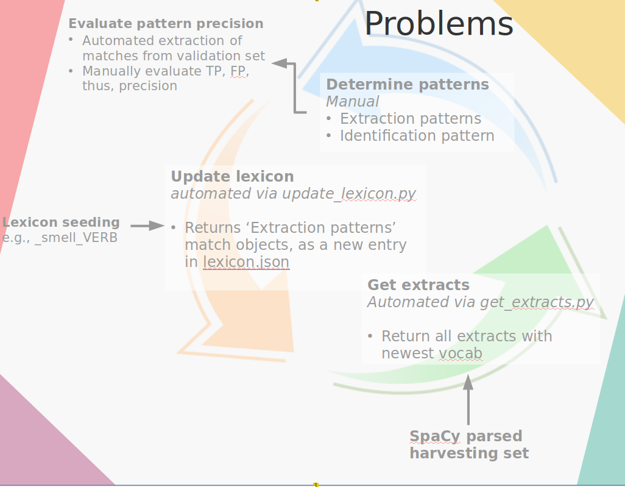
Common seed words can result in huge number of extracts, infeasible to inspect.
Solution:
Seed the process with single word only _smell_VERB
If the process stalls, other ‘known’, outside-of-process words can be used for seeding

Slide 3
There’s a lot of flexibility wrt. suitable vocab matches.
Initially, I’ll just target <nouns> used as smell references
e.g.
smell of fresh, moist paper and newsprint
i.e.
<smell_noun> _of_ [<noun>]

Slide 4
Problems
Evaluate pattern precision
Automated extraction of
matches from validation set
Manually evaluate TP, FP,
thus, precision
Determine patterns
Manual
Extraction patterns
Identification pattern
Update lexicon
automated via update_lexicon.py
Returns ‘Extraction patterns’ match objects, as a new entry in lexicon.json
Lexicon seeding
e.g., _smell_VERB
Get extracts
Automated via get_extracts.py
Return all extracts with
newest vocab
SpaCy parsed
harvesting set

